Slide 1
Traffic Modelling System
Team: Ekathra
By:
Ashwini Cherukuri
Rupanandha Moori
Sahil Nokhwal
Rama Naveen Kommuri
Laxmi Sai Teja Naraharasetty
Vamsi Chowdary Bobba
Manikanta Nomula

Slide 2

Client and Mentor
Client & Mentor: Dr. Michael Oudshoorn
Associate professor in the School of Computer Science and Information System

Slide 3
Outline
Project Management Plan
Challenges & Issues
Use case diagrams
Software Architecture
Work Estimation
Demo & Sample screens

Slide 4
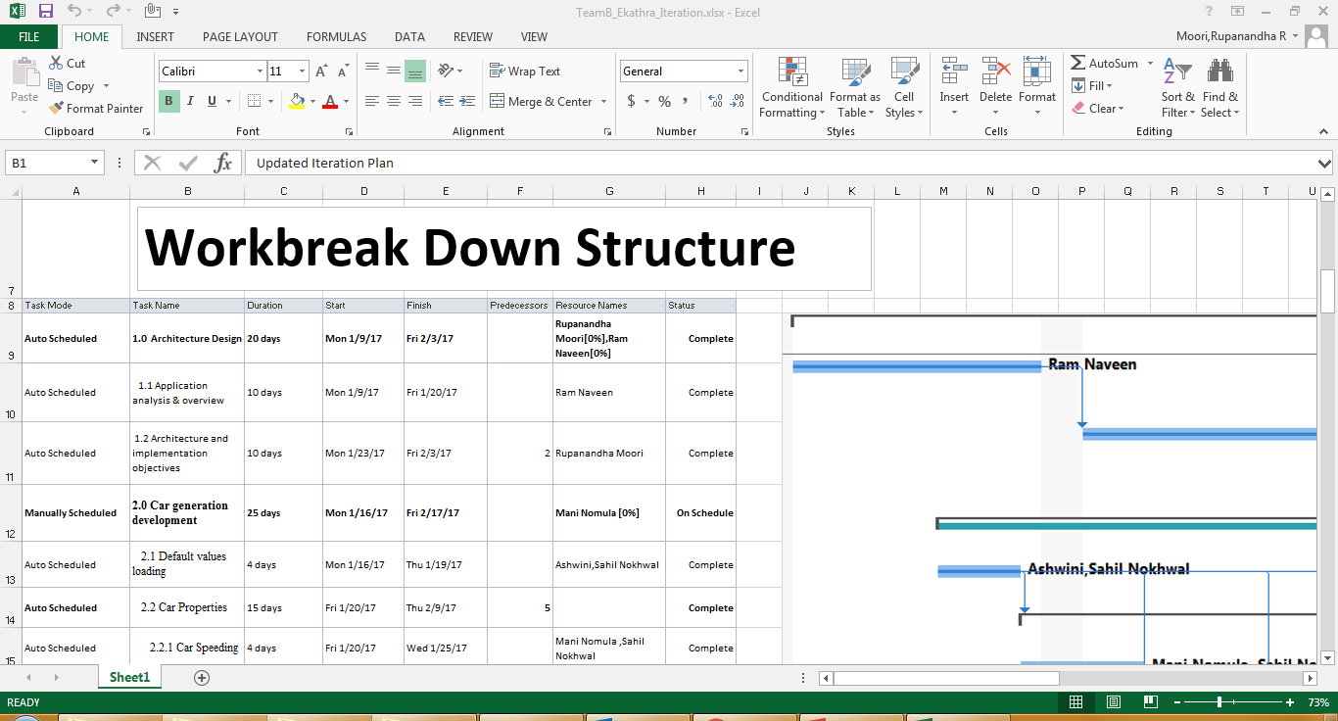
Project Management Plan

Slide 5
Project Management Plan:
We are spending about 15 hours per person per week which makes a total of 85hours per week per team.
The total budget of the project is 85X24 = 2040.
Per week per person: 15X1 = 15
Per week per team: 15X7 = 85
Total hours per team: 85X26 = 2210 hours.
26 weeks is the total number of weeks the project is going to take.

Slide 6
Challenges & Issues
The major problem right now we are facing is passing the object references from one panel to other panel.
Capturing the car count at the intersections.
Assigning the rank to the cars at intersections based on arrival time.
Code integration is breaking the existing functionality.

Slide 7
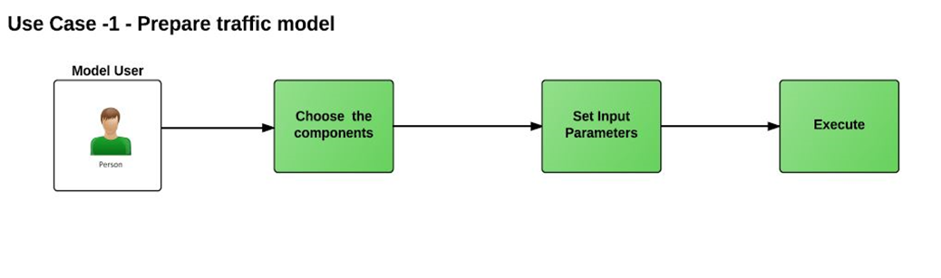
Use case diagram

Slide 8
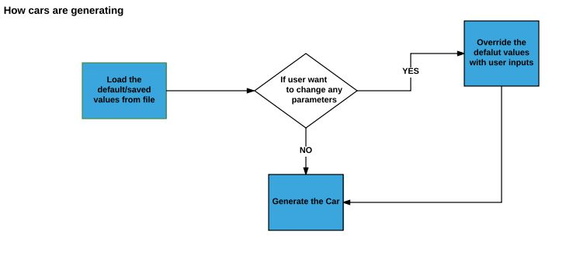
Use case diagram (Contd..)

Slide 9
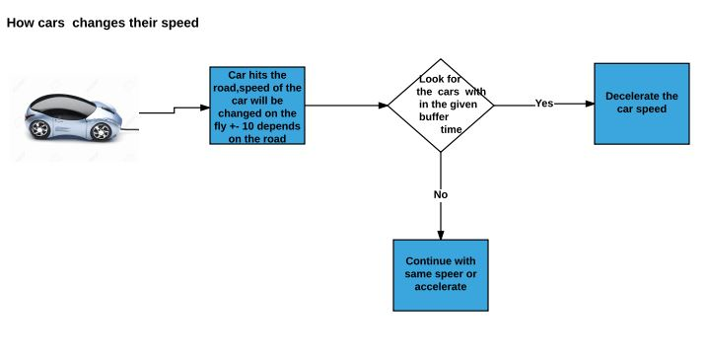
Use case diagram (Contd..)

Slide 10
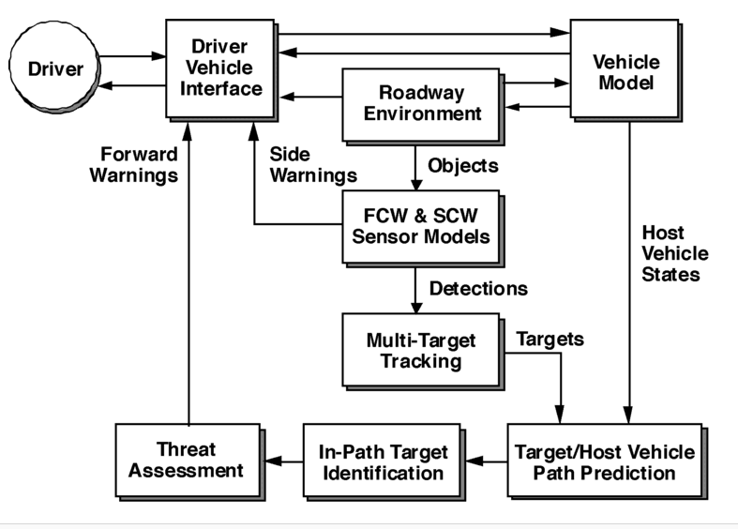
Software Architecture

Slide 11
Work Estimation
To the best of team knowledge we are expecting 1000 -1200 man hours .
So far we have coded 2300 lines .
We are anticipating anywhere between 4k -5k lines of code to finish the project.

Slide 12
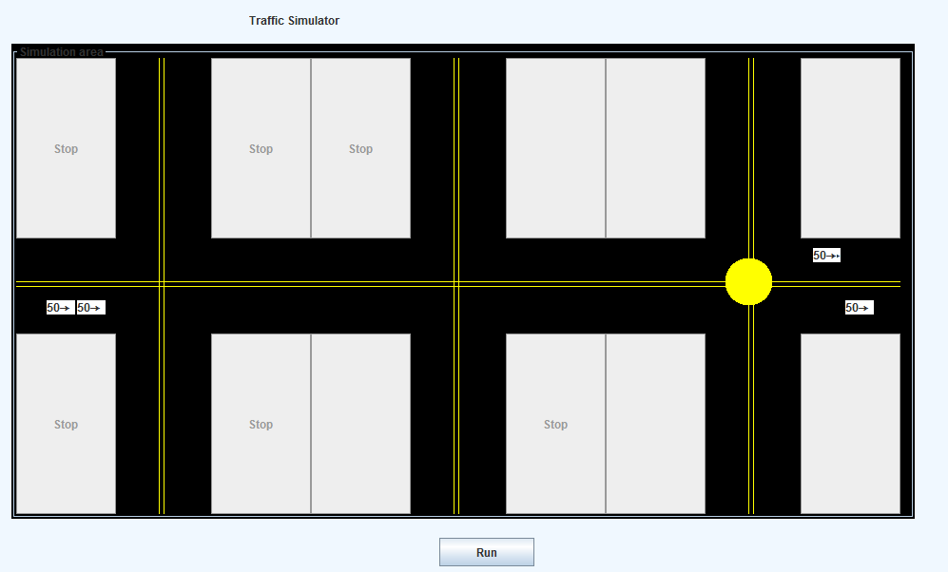
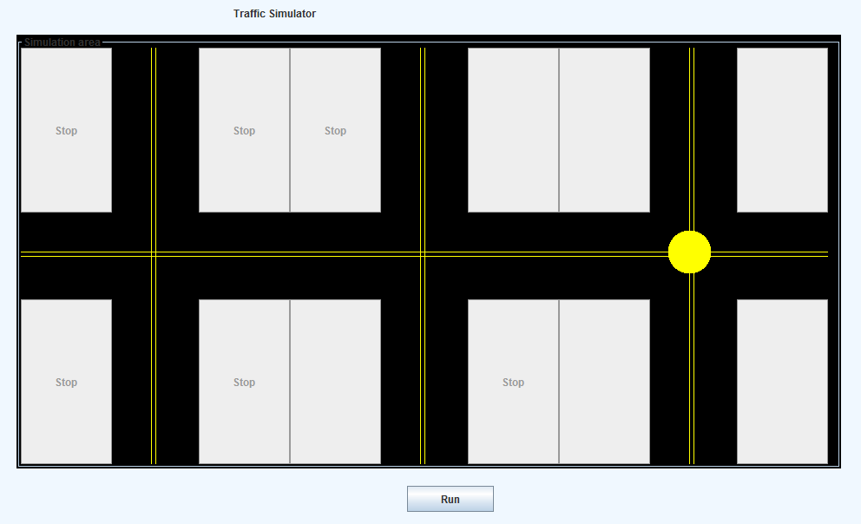
Demo & Sample screens
With cars
With out cars

Slide 13
Thank you !

